Slide 1
Tendrils of Crime
Visualizing the Diffusion of Stolen Bitcoins
Mansoor Ahmed, Ilia Shumailov, Ross Anderson
GraMSeC 2018. Presented by Mansoor Ahmed. Some slides adapted from Anderson, WEIS 2018.

Slide 2
Presentation Strucure
Bitcoin Primer
Necessity of Tracing
Legal Precedent
Taintchain
The Visualization Problem
Prototype Solution(s)
Generalization and Future Directions

Slide 3
Bitcoin Primer
Unspent Transaction Outputs (UTXOs): Bitcoin-speak for how much you can spend
The fundamental quantum of spending in Bitcoin is the “satoshi”. 1 satoshi = 10⁻⁸ bitcoins
Total amount in your “possession” is the total number of satoshis in all the UTXOs attributed to all the private keys under your control

Slide 4
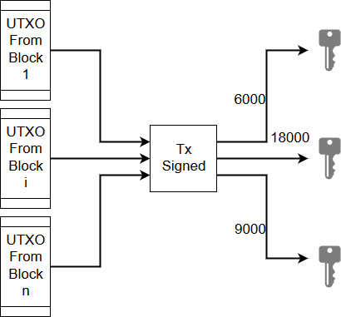
Bitcoin Transactions
Effectively, a transaction consists of a set of input UTXOs, a set of output public keys (and values) and a signature by the owner(s) of the UTXOs:

Slide 5
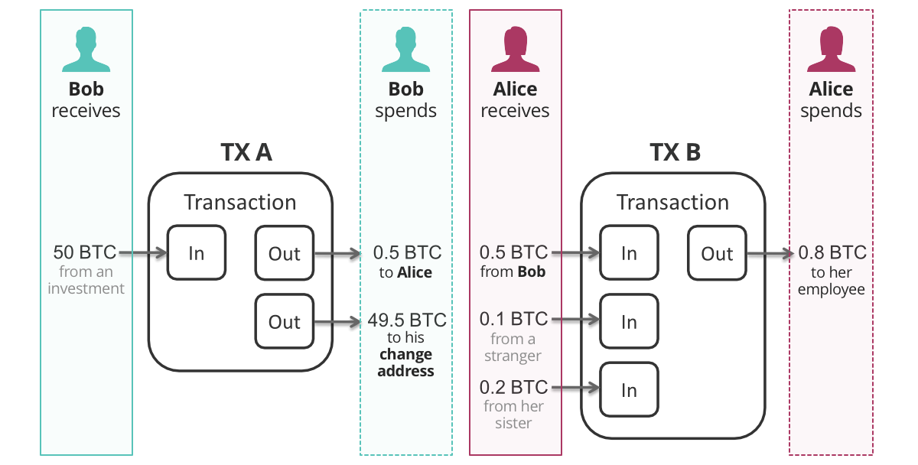
Bitcoin Transactions
Image from [2]

Slide 6
Bitcoin Transactions
Bitcoin transactions can be one of the following types:
1-to-1: Only one key gets assigned the single input UTXO
Many-to-2: Input UTXOs get split into two outputs (most common)
1-to-many: Input UTXOs get split into many outputs
Many-to-many: As above, with multiple signatories
Multisig transactions: Threshold signature required on input UTXOs

Slide 7
Necessity of Tracing
Recent news: $761 million worth of cryptocurrencies stolen in the first six months of 2018^{[1]}
It is estimated that 6-9% of bitcoins have been stolen at least once
Bitcoin has also facilitated the rise of new kinds of crime such as ransomware
Currently, there is no universal legal or technical recourse for victims of theft/ransomware.

Slide 8
How is tracing done?
The Bitcoin community, at large, believed that there are two ways to do tracing: Poison and Haircut.

Slide 9
Legal Precedent – or Why Mixes Don’t Work
Turns out, lawyers and judges have been thinking about tracing stolen goods for a very long time.
Important consideration: Is Bitcoin money or is it a good?
Different jurisdictions taking different views – often inconsistent and convoluted but not never as far as money.
FinCEN rules can be applied to mitigate money-laundering risk

Slide 10
Nemo dat quod non habet
“No one gives what he doesn't have”
If Bob steals Alice’s horse and sells it to Charlie, then when she sees Charlie riding it she can demand it back. Charlie never “owned” the horse.
There is no statute of limitations for theft.
Escape route: Fungibility. Banknotes are legally fungible while grains of wheat are technically fungible.
Each bitcoin records its entire history of transactions!

Slide 11
Clayton’s Case
Devaynes v Noble (1816) 35 ER 781
When sorting out a bankruptcy, the court said the first-in, first-out (FIFO) rule should determine the effect of payments to and from an account*
Part of English Law, has spread to most Commonwealth jurisdictions.
What does this mean for bitcoin?
*What constitutes an “account” in the case of Bitcoin is a non-trivial question…

Slide 12
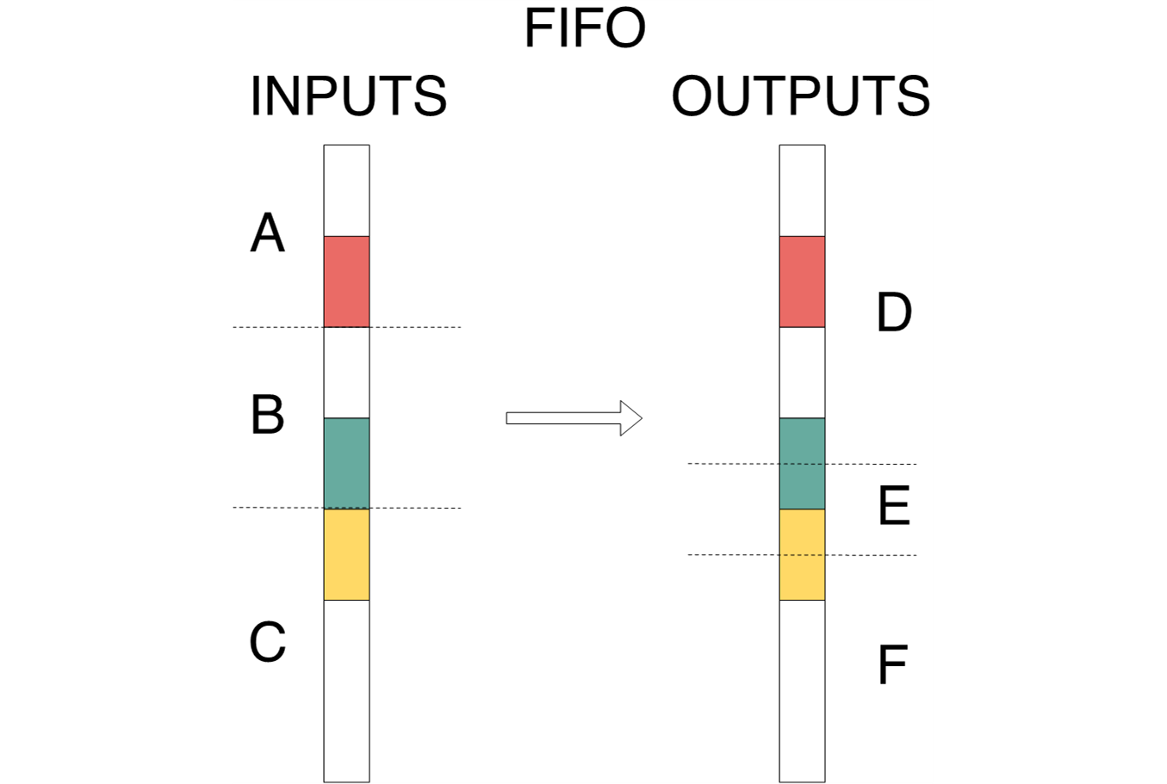
Clayton’s Case

Slide 13
Taintchain
Putting the FIFO and Nemo dat rule together leads to an elegant recipe for tracing
If a UTXO is marked as dirty, trace its component satoshis and mark each of them as tainted until you reach the end of the blockchain
We implemented this; source code available at taintchain.org
We started from 56 well-known thefts and associated addresses, and ran taintchain on it.

Slide 14
Taintchain – Sample Results
Example 1: Linode hack. 46,653 bitcoins stolen in 2012.
Haircut now taints 16,855,619 addresses. FIFO only taints 254,120 addresses.
Example 2: Flexcoin hack. 896 bitcoins stolen in 2014.
Haircut now taints 10,421,122 addresses. FIFO only taints 15,265 addresses

Slide 15
Why FIFO is better
Haircut tainting is lossy; can’t go backwards
FIFO tracking is lossless so tracing is reversible
You can go forward from a stolen coin to all UTXOs it taints, or back from a UTXO to see its entire ancestry
The handling of transaction fees is very different, as it’s fiddly (but important)
With FIFO, most UTXOs (72%) have no taint from our set of 56 well-publicized large thefts

Slide 16
The Visualization Problem
FIFO works well and proceeds deterministically. However, the dataset is massive: starting with the set of known thefts, our taintchain data ends up being >450 GB in size!
Analysis of dataset further complicated by mixes. Money launderers use varying mechanisms to slice-and-dice their criminal proceeds.
A visual representation of the flow of taint could prove to be very useful in finding these mechanisms
Moreover, it could also help prospective bitcoin purchasers verify the ancestry of their bitcoins (reversibility of FIFO)

Slide 17
The Visualization Problem – Prototype 1
Each transaction is a node, each taint hop is an edge.
Represent blocks as columns in chronological order
Represent transactions within each block as coloured rectangles.
Colour reflects the kind of taint, size of rectangle reflects amount of satoshis tainted
Ignore all non-tainted satoshis
Print this in a static PNG image with clickable links on each transaction rectangle revealing the txhash.

Slide 18
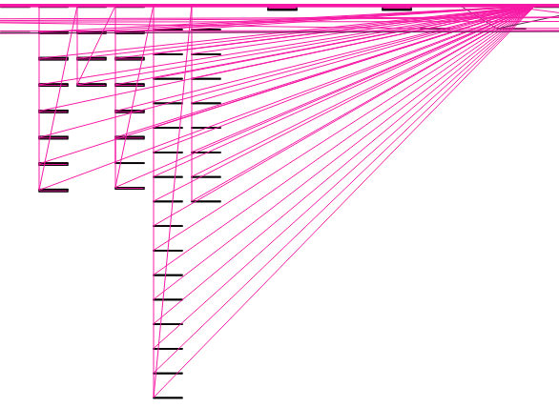
Sometimes, this worked beautifully
Here, our visualization reveals the collection of thefts scattered across multiple
blocks and keys under a single key.

Slide 19
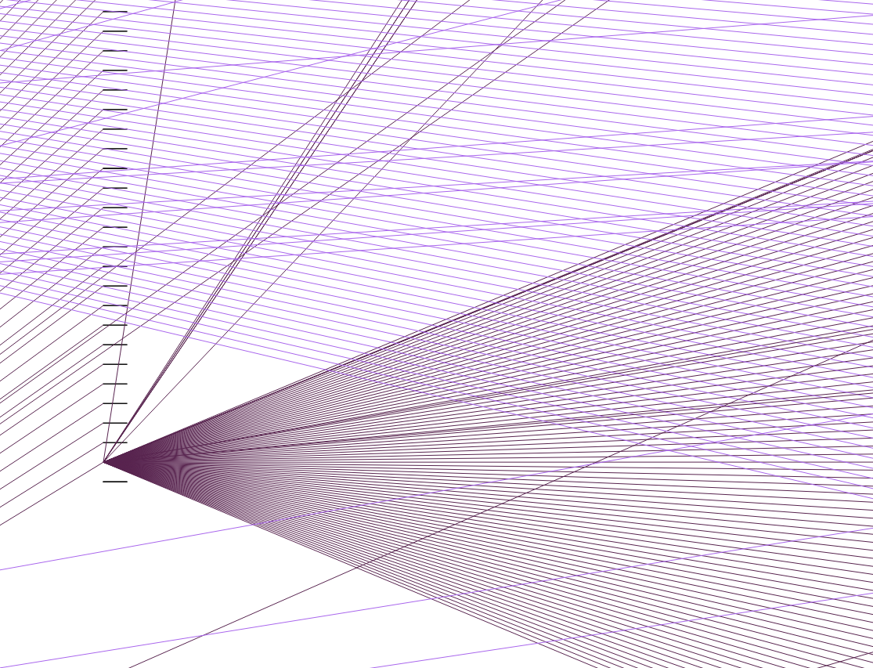
Sometimes, this worked beautifully
Here, our visualization reveals someone trying to lauder their proceeds by
splitting the value across a large number of keys.

Slide 20
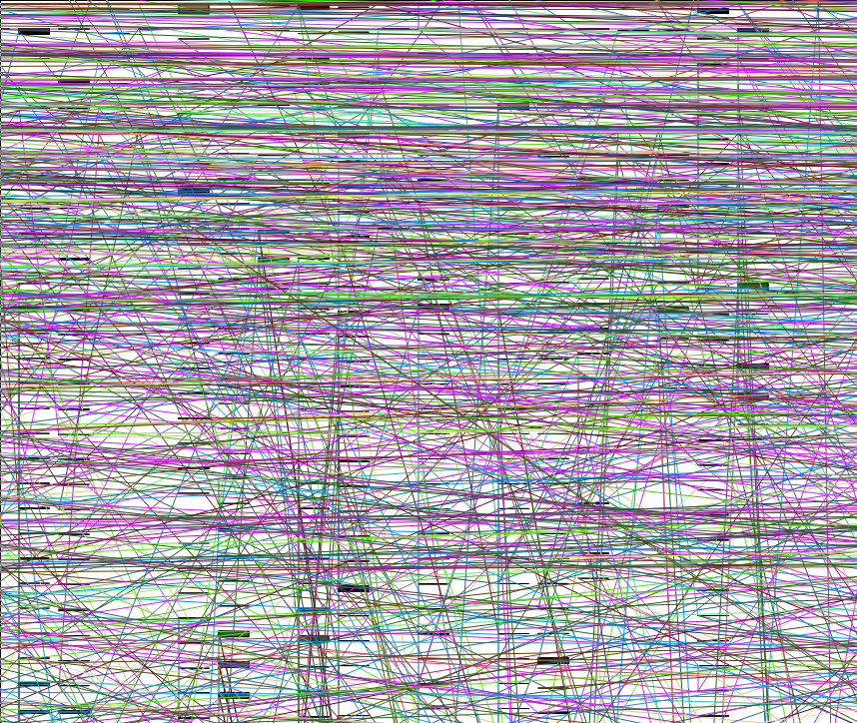
Sometimes, not so much
The criminals were really busy that day

Slide 21
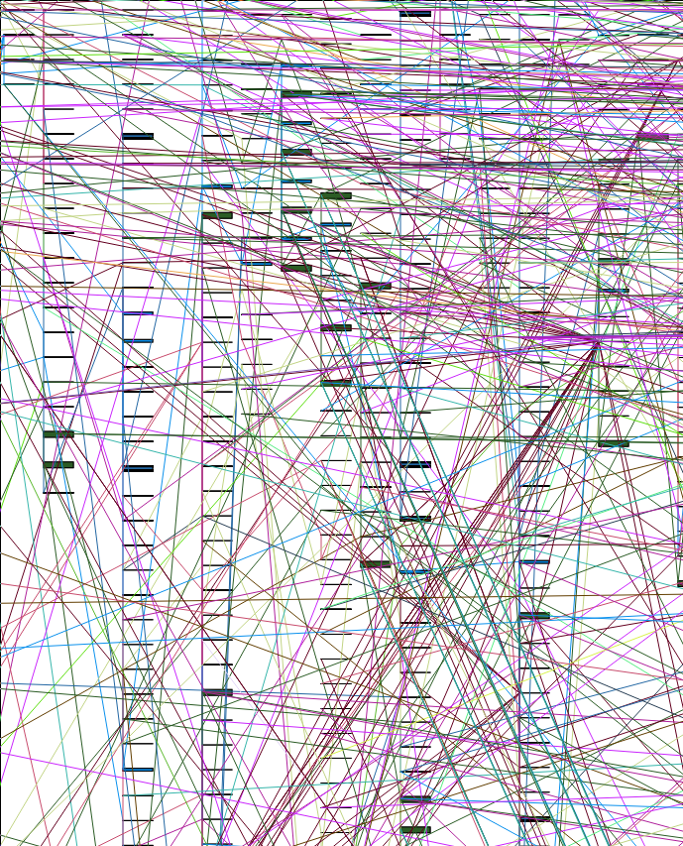
Sometimes, not so much
Taint tends to overlap making visualization difficult

Slide 22
Prototype 2
We wanted to be able to meaningfully visualize dense data without using any abstractions.
Idea: Make the graph interactive, incorporate relevant information into the edges. We implemented a dynamic graph that expands based on user commands.
Problems: dataset size (RAM << 1000GB), unbounded number of hops, lack of user knowledge about which path is most interesting
We solved some of these issues while some are still a work in progress.

Slide 23
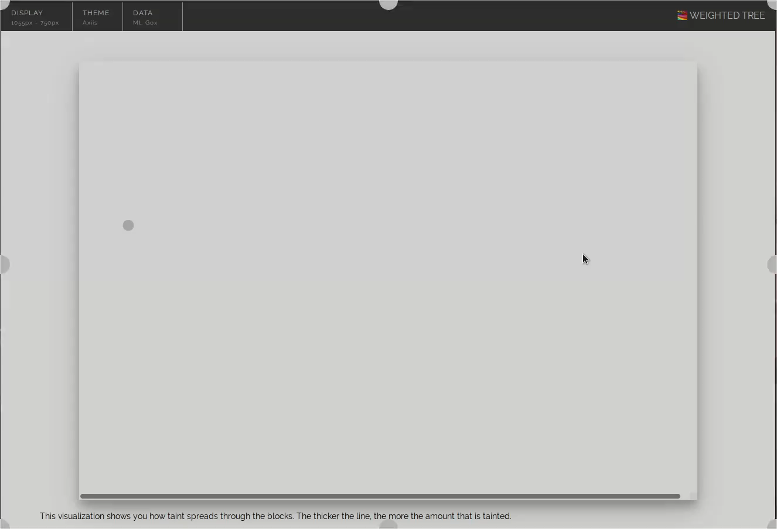
Prototype 2 - Demo

Slide 24
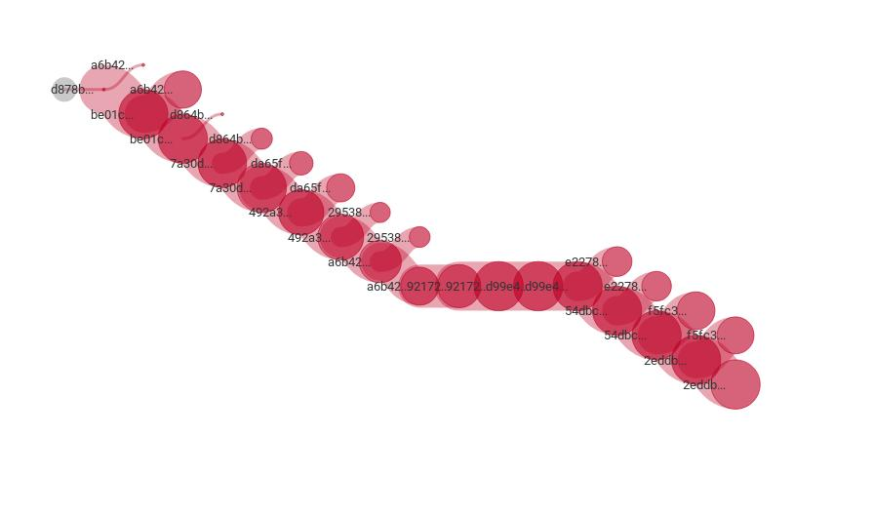
This too worked beautifully sometimes
A “Peeling Chain” discovered by following the largest branches from a theft

Slide 25
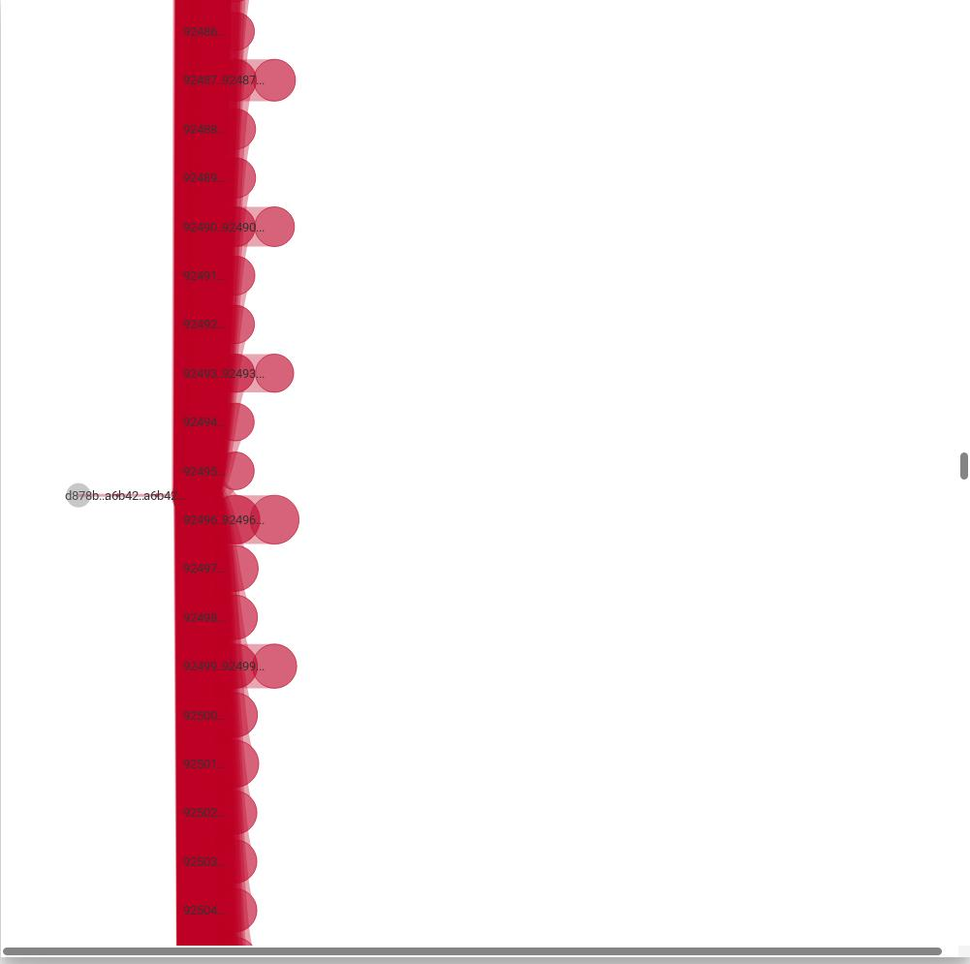
Sometimes not so much
Some nodes have very large out-degrees (notice vertical scroll size)

Slide 26
Optimizations
We don’t care about most of the transactions on the blockchain.
Most tainted transactions can also be abstracted away:
1-to-1 transactions can be collapsed
1-to-x-to-1 transaction chains can be resolved to 1-to-1 with some adjustments
Interactive graphs allow for cumulative views without removing information

Slide 27
Generalization
In the end, what we are trying to do is visualize a large subset of transactions in a massive dataset with an unbounded number and length of hops
The added complication here is the lack of ground truths and consequently, lack of reliable heuristics for generalizations
We’ve explored some – timing information, clustering datasets, interactions with known bad actors
Each gives a different, incomplete, view of the dataset

Slide 28
Future Work
Implement and make publicly available the different abstracted visualizations
Make the visualization real-time a la blockchain.info
Explore ways of transitioning from abstraction to transaction level granularity
Find heuristics to pre-emptively mark suspicious transactions. This could help law enforcement get a heads-up on possible criminal activity.

Slide 29
Thank You
One-slide Summary:
Tracing stolen bitcoins is important. The law tells us FIFO is the way to go.
Generating the tracing database is easy. Finding interesting patterns is hard. Visualization helps.
Visualization requires dealing with data density and magnitude. We presented our two attempts at doing this effectively
Need to explore further ways of visualizing without relying on shaky heuristics (as other tools have tended to do).

Slide 30
References
https://www.reuters.com/article/us-crypto-currencies-ciphertrace/cryptocurrency-exchange-theft-surges-in-first-half-of-2018-report-idUSKBN1JT1Q5
https://freedomnode.com/guides/17/how-bitcoin-works

